Slide 1
Stop Wasting Your Time With Utilities!
Speaker: Jim Dee
Company: BMC Software
Platform: Db2 for z/OS
Notes:
What is the ideal frequency of execution for most utilities? We will start by discussing the answer to that question, and then move on to how to implement a strategy to achieve it. The focus will be on REORG, RUNSTATS, and COPY. Hint: the answer is automation.
The title of the presentation stems from the realization that utility execution does not directly contribute to the revenues or profits of your enterprise. In addition, there are more effective ways for you as a DBA to contribute to your business. Spending time setting up utility JCL, checking JCL, monitoring job execution, and checking results is stealing valuable time from you.
This presentation focuses on automation of utility execution, but we will not talk about any particular automation tool, or even how to build your own automation. We will talk about the goals of an automation strategy, and the operational characteristics of the different utilities that might drive your strategy.

Slide 2
Agenda
What is the ideal execution frequency for REORG, RUNSTATS, and COPY?
How can we plan to get as close as possible to that ideal?
We will look at the details of REORG, RUNSTATS, and COPY from an operational perspective.
How can we exploit RTS as part of an effective utility automation strategy?

Slide 3
Dream Objective
Answer one simple question: “What is the ideal frequency of execution of REORG, RUNSTATS, and COPY, and how close can we get to it?

Slide 4
Close to Ideal Timing
Want to run REORG and RUNSTATS just often enough to maintain application performance
For static SQL, no point to RUNSTATS if not rebinding
Want to run COPY just often enough to:
Keep log apply manageable during a potential recovery
Avoid COPYP status
Notes:
We will talk about the details of these general descriptions of frequency.

Slide 5
Why Do We Run REORG?
Online Schema Change materialization
Extent consolidation? Seriously?
7,000 and change isn’t enough?
No performance impact today
Making available the space for pseudo-deleted rows or index entries
Rebalancing or freeing space by partition
Which leaves us with performance…
Notes:
And of course there are special projects, like extending the RBA or LRSN in DB2 11 NFM. That must be a special project, and you probably don’t want to automate the reorgs to accomplish the extension. However, one possible approach is to simply run your regular reorgs.
In DB2 10, DB2 started “pseudo-deleting” tablespace rows, to support the Last Committed Read feature. In DB2 11, DB2 added a daemon to periodically clean up pseudo-deleted index entries, so the need for reorgs is correspondingly reduced.
You can somewhat automate the reorgs to free space, if you run RUNSTATS with the UPDATE SPACE parameter, or you have another way to collect equivalent information,.

Slide 6
Perfect Time to Run REORG
Response Time
Phone calls start about here…
Time Since Last REORG
Ideal input would be performance trend for every SQL statement against the object
Notes:
Ideally, we want to run a REORG of each space just before the performance of the important SQL statements against that space degrades. One challenge is knowing in advance what the performance curve will look like. If you have a test system which mirrors production in terms of data volumes and transaction volumes and timing, you can derive these curves. Otherwise, it’s just trial and error.
A second challenge is knowing that a REORG will fix the problem. We will discuss that more in a few slides.
Extracting and saving these performance metrics is an expensive exercise. For most spaces, it may not be necessary on an ongoing basis. In some cases, you may find that the optimal time to REORG is between three and five days, for example, and you may simply decide to schedule a REORG every three days.

Slide 7
Performance Data is Expensive to Collect (1|2)
REORGINSERTS
Response Time
REORGUNCLUSTINS
REORGCLUSTERSENS
Time Since Last REORG
Notes:
Even for those spaces where the range of optimal times is wider, it may not be necessary to continue extracting performance numbers. If you derive the performance numbers once in conjunction with the appropriate Real Time Statistics values (we will discuss appropriate RTS values later), you can use the RTS values as surrogates for the performance numbers.
Note that the use of Solid State Disk (SSD) can drastically change your threshold values here, by significantly reducing the cost of synchronous I/O. zHyperlink usage in DB2 11 and later can also have the same effect.
Now I have some bad news.

Slide 8
Performance Data is Expensive to Collect (2|2)
REORGINSERTS
Response Time
REORGUNCLUSTINS
REORGCLUSTERSENS
Time Since Last REORG
Notes:
REORGCLUSTERSENS does not reflect executions of range predicates which retrieve multiple rows based on the leftmost columns of the clustering index, which is logically what it should indicate. It is incremented based on the assumption that just about any access could depend on clustering, so it tends to trigger many false positives. So, now I have some good news, about a couple of metrics which are more useful than REORGCLUSTERSENS.
The interesting thing about this diagram is that the RTS values can tell you your tablespace is disorganized, but not whether your application is such that a REORG will improve your performance.

Slide 9
Better Metrics than REORGCLUSTERSENS
Notes:
Two very interesting metrics are number of asynchronous IO’s per time period, and the number of synchronous IO’s. The use of async IO reflects prefetch, and its existence indicates access to the table that is affected by clustering. Immediately after the tablespace is reorged, a range predicate driven by the clustering index will find almost all of its pages via asynchronous reads. As time goes on and the data becomes more disorganized, the number of asynchronous IO’s will decline and the number of sync IO’s will increase. Of course, the absolute numbers of getpages and IO’s will vary with the size of the tablespace and the percentage of data being retrieved. The more usable metric is the ratio of async to sync IO’s; when this falls below a threshold, it indicates a need to REORG to restore clustering.
These charts are hypothetical, and reflect one SQL statement which is affected by clustering, because it includes a range predicate on the clustering index and typically retrieves many pages. The effect across all SQL for a tablespace will be diluted by other statements. You have to decide on the balance between incurring the cost of the REORG versus the importance of the clustering affected statements to the business.
Of course, you need to measure CPU usage and response time for the appropriate SQL statements, and correlate them to the trend in the ratio of async to sync.

Slide 10
What to do, what to do?
REORGCLUSTERSENS is useless as a REORG indicator
Finding async and sync IO counts is too expensive!
More good news: most applications don’t change much over time
You need to run a monitor or performance trace once, to correlate the threshold values for REORGUNCLUSTINS with performance degradation
Record the async and sync values over time to decide if REORG TABLESPACE will benefit your application

Slide 11
Finally…
Response Time
Time Since Last REORG
Is this slow growth trend in response time reflecting data volume growth, or will a REORG restore performance?
Notes:
From the performance data alone, this is a hard question to answer. Of course, you can simply run a REORG and see what happens. You can extract tablespace size data over time; as long as it correlates with performance data, a REORG will probably not solve your issue.

Slide 12
REORG … INDEX or TABLESPACE?
Random or sequential access can be vulnerable to disorganized indexes
REORG INDEX may solve your performance issue
Do you run data sharing?
How many page splits do you have?
How much index contention do you see?
MEMBERCLUSTER might solve that problem…but
FTB will help for random
Insert Algorithm 2 may help
Notes:
If an index is disorganized enough to actually add a level, all index access will trigger more getpages.
If random access occurs in “hot spots” (i.e., accesses in the same period of time tend to access the same keys), it will degrade at least as much as sequential access.
An index page split in data sharing is particularly damaging to performance. Running REORG INDEX frequently enough to avoid page splits can enhance performance significantly.
You need to consider combining REORG INDEX runs with REORG TABLESPACE for the tablespace associated with the index. Be careful not to run at significantly different times and get the index and tablespace statistics out of sync.
The FTB (index caching) feature in DB2 12 improves the performance of index probes for random access. You probably should redo your performance analysis in DB2 12 (FL100) to allow for this.

Slide 13
Index Performance Data is Expensive to Collect
Response Time
REORGLEAFNEAR
REORGNUMLEVELS
REORGLEAFFAR
Time Since Last REORG
Notes:
This chart corresponds to the chart we looked at earlier, for tablespace values; this one is for indexspace values. REORGLEAFFAR is the single most important value to understand here. It reflects the relative amount of synchronous I/O that will occur against the index, because of page splits which lead to the condition where logically contiguous pages are too far apart to be included in the same prefetch request. REORGLEAFNEAR also reflects the number of page splits, but the effect of logically contiguous pages which are “close” is much less. You need a check for REORGNUMLEVELS; if it is greater than zero, the effects can be significant for random access. If an index goes from three levels to four, for example, the number of getpages per random request will increase by a third.

Slide 14
Can You Trade DASD for Performance? (1|2)
PCTFREE=10
Response Time
REORGINSERTS
REORGUNCLUSTINS
Time Since Last REORG
Notes:
This is the same diagram we’ve seen before, showing how the performance curve has a “knee”, based on REORGUNCLUSTINS passing a critical threshold.

Slide 15
Can You Trade DASD for Performance? (2|2)
REORGINSERTS
PCTFREE=20
Response Time
REORGUNCLUSTINS
Time Since Last REORG
Notes:
Compare the last chart to this one. We doubled PCTFREE from 10 to 20 percent. The curve for REORGINSERTS is the same, but the inserts are going into different pages. The curve for REORGCLUSTERSENS is the same; the application hasn’t changed. The changes are to the curves for REORGUNCLUSTINS, which has stayed below its threshold longer, and the performance curve for SQL against the space, which has also degraded more slowly. The net effect is that a REORG can be run safely with a lower frequency. Considering the relatively low cost of DASD, it may be worth considering adjusting PCTFREE and using more DASD to ensure better performance at a lower cost in reorgs.
If indirect references are a concern for you, you can defer reorgs to correct them with PCTFREE FOR UPDATE, added in DB2 11.

Slide 16
Operational Considerations for REORG
Want cost of REORG to be lower than application gains
Don’t run during peak of R4HA
Don’t run during high access period
Use thresholds on correct metrics to run reorgs when required but only when required
REORG … SORTDATA NO CLUSTER NO resets RTS
Notes:
Be aware that, if you run a REORG with SORTDATA NO CLUSTER NO to, for example, materialize a schema change, the REORG resets RTS values, and can delay the automated REORG you want to execute.
Now let’s turn our attention to the RUNSTATS utility.

Slide 17
What is the Ideal Frequency for RUNSTATS?
Assuming you’ve automated your reorgs and you’re maintaining your spaces…and your application performance…
Almost never!
Notes:
If you’re successfully running automated reorgs to keep your applications optimized, you don’t need or want to change access paths. Assuming fairly steady, or even not so steady, growth in data volumes, this still remains true. There are some possible exceptions.

Slide 18
Why Do We Run RUNSTATS? (1|2)
Schema changes (including adding or changing indexes)!
Some application code changes
Data volume changes
Must be significant!

Slide 19
Why Do We Run RUNSTATS? (2|2)
To add new statistics
Which don’t exist but are necessary
To exploit RUNSTATS improvements
Why run RUNSTATS if access paths won’t change?
Must REBIND static packages

Slide 20
Optimizer Help for RUNSTATS (1|2)
BIND
DSN_STAT_FEEDBACK
Available in V11 CM
EXECUTION
Available in V11 NFM
Analysis
SYSIBM. SYSSTATFEEDBACK
RUNSTATS
Notes:
The pertinent method here is the second, which becomes available after you migrate to NFM of DB2 11. In this case, the data is stored in a catalog table, SYSIBM.SYSSTATFEEDBACK.
This method will detect missing statistics; note that it will not notify you of existing statistics which are unnecessary. It should also allow you to react to schema changes and application code changes, with a delay, since these will probably manifest themselves as missing statistics. For example, if you create an index, but do not collect statistics for it, a SQL statement which could use it should create a row in SYSIBM.SYSSTATEFEEDBACK with the correct INDEXNAME, TYPE ‘I’, and REASON ‘KEYCARD’.
Be warned that there is no guarantee that the optimizer will use new statistics calculated in response to SYSSTATFEEDBACK. It will consider them. You should EXPLAIN the appropriate statements after RUNSTATS and ensure that you’re not spending cycles extracting statistics which will not be used.

Slide 21
Optimizer Help for RUNSTATS (2|2)
BIND
DSN_STAT_FEEDBACK
Available in V11 CM
EXECUTION
Available in V11 NFM
SYSIBM. SYSTABLES_PROFILES
SYSIBM. SYSSTATFEEDBACK
Available in Db2 12
RUNSTATS
Notes:
IBM closed the loop in Db2 12, making stats feedback from execution directly available in RUNSTATS profiles. With some care, this allows you to exploit the latest analysis from the Optimizer every time you run RUNSTATS. You still need to review periodically and check for obsolete or mismatched statistics.
IBM has added “stale statistics” as a feedback reason in DB2 12.

Slide 22
Operational Considerations for RUNSTATS
RUNSTATS is not as disruptive as REORG, but it does have a cost
Associated BIND or REBIND is more disruptive
Exploit the increased concurrency in DB2 11
Exploit REBIND phase-in in DB2 12 FL505
Use Access Path Stability!
Consider saving old stats conveniently, so you can back out quickly if paths regress
Notes:
Now we will move on to discuss the COPY utility.

Slide 23
Why Do We Run COPY?
Primary purpose is to provide data to RECOVER utility
Secondary purpose is to allow updates after a REORG or LOAD
Secondary purpose could be as source for data migration
Frequency is a function of how much log would have to be applied during RECOVER
Notes:
How many people test, or even estimate, recovery time to decide on copy frequency?
An important change in DB2 11 is the ability to run copies concurrently with reorgs, against the same sets of objects. This removes one constraint on the timing of your copy runs.

Slide 24
Is There a Perfect Time To Run COPY
Risk of updating resume starts about here
Time to Run Recovery
Time Since Last COPY
Ideal input would be perfect knowledge of worst expected recovery time, as of every point in time
Notes:
Ideally, we want to run a copy of a space when the anticipated recovery time exceeds a threshold because of log apply time. Remember that it’s the point of recovery that matters (assuming we are insuring against logical damage leading to a PIT recovery), and that will depend in large part on your organization’s business continuity policies. We are assuming that a recovery to just before current would lead to the longest recovery time. The other factor here is backout, which will have the opposite slope of curve, getting more expensive as you decide to recover to further back in time. For purposes of planning, you may want to be more conservative and assume that backout may not be available.
You should test your recovery periodically, maybe as part of a DR test. When you do, extract the recovery time information you need to consider reducing or increasing the frequency of your image copies.

Slide 25
Is It Possible To Avoid a COPY?
What if the space has not been updated since the last copy?
Not realistic often in production
What about test systems?
You may be able to save time and storage space with incrementals
Do you want to copy indexes?
Do you know at what point the savings in rebuild time outweigh the cost of making index copies?
You still have to apply the log!
Test recovery!
It’s the only way to know if your copies are frequent enough

Slide 26
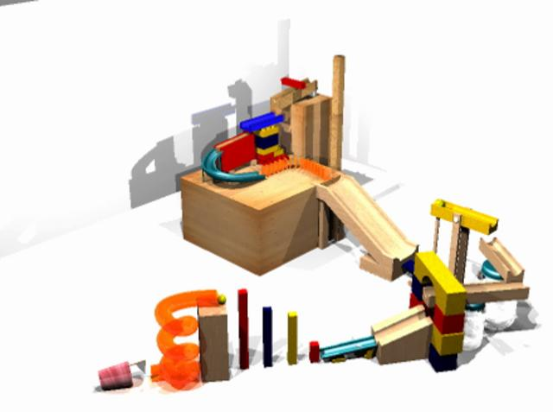
Characteristics of Automation Solution
It should submit utilities as soon as possible after need is detected
It should time execution to minimize application outages
It should consider system load
It should use LISTDEF and PARALLEL (where possible)
Ideally, it should handle failure smoothly, and requeue failed utilities automatically

Slide 27
Summary
REORG is the biggest opportunity for automation
Be careful with RUNSTATS!
COPY automation is best done in the context of a recovery strategy

Slide 28
Speaker: Jim Dee
Company: BMC Software
Email Address: jim_dee@bmc.com
Live Q&A Session in Room3, on August 7,2020 1:45-2:15 EDT

Slide 29
Mainframe Database DevOps
BMC AMI
Security
Systems
Cost
Data

Slide 30
Automation Everywhere
Enablers of the Autonomous Digital Enterprise
Transcendent Customer Experience
Enterprise DevOps
Autonomous Digital Enterprise
Five strategic technology-enabled tenets to help customers become Autonomous Digital Enterprises
Adaptive Cybersecurity
Data-driven Business
Notes:
The Autonomous Digital Enterprise (ADE) comprises intelligent, interconnected, technology-enabled value-creating systems that operates with minimal human involvement or intervention across every facet of the organization and its ecosystem of partners.
It is the evolution of growth-minded organizations looking to deliver value with competitive differentiation enabled by agility, customer centricity, and actionable insights.
The transformation to an Autonomous Digital Enterprise is not static or sudden.
It requires organizations to take progressive steps to leverage more automation, AI, and machine-learning capabilities as the foundation for all the enablers.
Building on their existing strengths, companies need to continue to run their business as they evolve and reinvent their operations for the future.
BMC has long been a recognized leader for software solutions across both mainframe and distributed systems, providing robust and scalable solutions to complex IT problems.
As digital transformation has mandated an evolution that embeds technology across the enterprise, BMC has embraced the opportunity to leverage advanced analytics and automation across our solution portfolio.
As a result, customers see optimized performance, cost, and security in their technology investments.
Distinctive professional services complement the innovative portfolio that support the evolution to an Autonomous Digital Enterprise.
Organizations in every industry can easily leverage the scale, resilience, and reliability of the BMC portfolio to “reinvent” their businesses.
Transition: BMC Automated Mainframe Intelligence (or AMI) is how we help our customers modernize their mainframe environments and move toward becoming autonomous digital enterprises.

Slide 31
BMC AMI Automated Mainframe Intelligence
Security
Secure and protect your business critical data
Systems
Simplify your systems and performance management
Data
BMC Db2 products will be relaunch as BMC AMI products in 2020
BMC AMI
Security
Systems
Ensure your data is always available and optimized with next generation, automated solutions
Cost
Data
Cost
Drastically lower your MLC Costs with proven MLC cost-reduction solutions
Control Costs
Reduce Risk & Waste
Ensure Performance
Deliver Business Value
Increase Agility
Empower Early-in-Career Staff
Notes:
AMI (AUTOMATED MAINFRAME INTELLIGENCE)
Introducing AMI, the new face to BMC’s mainframe solutions. AMI enables you to automatically manage, diagnose, heal and optimize mainframe systems without manual intervention. AMI consists of modern analytics technology and built-in machine learning capabilities that will give you predictable and transparent insight into your mainframe environment. AMI is the autonomous driver you need for your mainframe.
AMI Is:
Intelligent visualization layers that help you understand your data and your environment like never before
AI-powered anomaly detection for real-time intelligent alarms
Pattern analysis to predict future performance, capacity or cost conditions
Intelligent root cause analysis for problem identification and faster resolution times
Cost-efficient management of peak workloads
Optimization of the resources you have
Fast and intelligent database maintenance with no downtime
Confidence in your ability to quickly perform recovery operations
Scalability of resources to meet your business demands
A better way to attract new professionals to the mainframe
Your mainframe link to enterprise analytics (Splunk, QRadar
AMI can help you with the entire range of challenges you’re trying to tackle on the mainframe today. Imagine monitoring thousands of metrics and having the system make decisions in real-time to ensure your mainframe is always running at peak performance. Imagine automatically finding and fixing issues before they become problems that impact your business. We’re here to help!

Slide 32
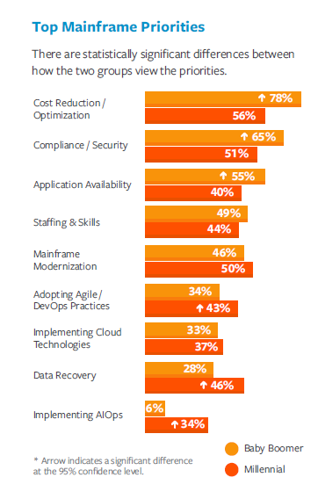
IBM Mainframe Agile/DevOps Adoption
2020 BMC Mainframe Survey Reports an even greater adoption of DevOps
56% of survey respondents are using DevOps on the Mainframe*
74% of companies that adopt DevOps see ROI in 1 year or less*
*2020 BMC Mainframe Survey to be published September 2020
The Next Wave of Mainframe Success –
2019 BMC Mainframe Survey Results
Link: https://www.bmc.com/info/mainframe-survey.html

Slide 33
DevOps Toolchain
PROJECT MANAGEMENT
IDEATION
AN IDEA
AGILE PROCESS
INTEGRATED DEVELOPMENT ENVIRONMENT (IDE)
IDE TOOLS
ANALYZE
EDIT
EDIT/MANAGE DATA
VALIDATE
DEBUG
VERSION CONTROL
CONTINUOUS INTEGRATION
CODE QUALITY
MEASURE
Release
DEPLOY
CODE COVERAGE
RELEASE
TEST
MONITOR
ITSM
Dev
ENVIRONMENTS
helix
DEV
TEST
QA
PROD
AMI
helix
IMS VIRTUALIZATION
DevOps for Db2
AMI

Slide 34
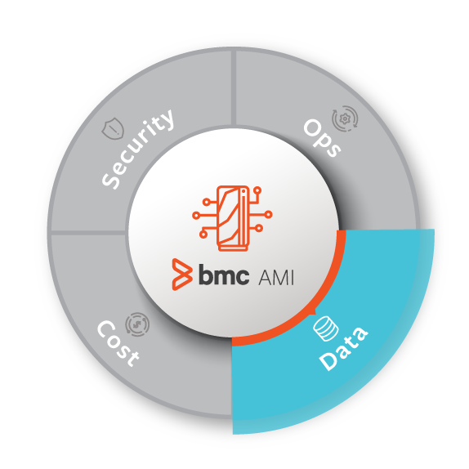
Parallel Development
Subsys: DB2P
PRD
PROD1.Employee
PROD1.Department
Use Cases:
Promotion to Next environment
Route to Live (path to PRD)
Merge (STG1 + STG2 into QA)
All Environment Synchronization
Clone Tables for New Testing Environments
Subsys: DB2A
QA
HLD
WXX700.Employee
WXX700.Department
WXX750.Employee
WXX750.Department
STG1
STG2
Subsys: DB2T
WXX831.Employee
WXX831.Department
WXX901.Employee
WXX901.Department
DEV1
DEV2
FIX
WXX830.Employee
WXX830.Department
WXX900.Employee
WXX900.Department
WXX950.Employee
WXX950.Department

Slide 35
BMC AMI Change Manager for IMS & Db2
IMS/Db2
Automation of Job Creation
Specification
Change Impact
Analysis
Intelligent Automation of Database Changes
Notes:
Direct or indirect dependence to the objects you are altering
Determine optimal strategy
Re-code DDL for all affected objects
Retain grants for affected objects
Unload tables with any required data conversions
Build reload format files
Drop affected tables
Recreate tables with changes
Recreate dependents
Recreate authorizations
Reload the new table
Recreate key constraints
Re-establish foreign keys and referential integrity to/from tables
Rebind invalidated plans and packages

Slide 36
BMC Database DevOps
Team
Production Approval
CI/CD Pipeline
Management
SELF SERVICE
Development Environment
Developer
Unit Test
System Test
Accp. Test
PROD
DevOps Lifecycle
Development
Smoke Testing
Quality Tests
Manual UAT
RUN
Unit Tests
Unit Integration Tests
Regression Testing
Performance Testing
Smoke Testing
Code Metrics
Functional Testing
Functional Testing
Training
Monitoring
Work Item A
Integration Testing
Work Item B
--- DB2 Test LPAR1 ---
LPAR2
LPAR3
DEV1
STG1
QA
HLD
PROD
Work Item C
BMC AMI DevOps for Db2

Slide 37
BMC AMI DevOps for Db2
BMC Workbench for Db2
BMC Catalog Manager for Db2
View Catalog
Generate DDL for all tables and Databases
Execute a broad variety of DDL, DCL, DML and Db2 Commands
BMC Web App for DBAs and Developers
Future Option
Jenkins
BMC Change Manager for Db2
Input change worklist
Generate all Change JCL
Make all changes\rollback including Copies, Reorgs, Rebinds etc…
IBM UCD
IBM z/OSMF
Submit Generated JCL to trigger Changes
Dataset Reads and Updates
Extract Job History
Future Option
Db2 DDL and Table Schema Changes
*Conceptual Diagram

Slide 38
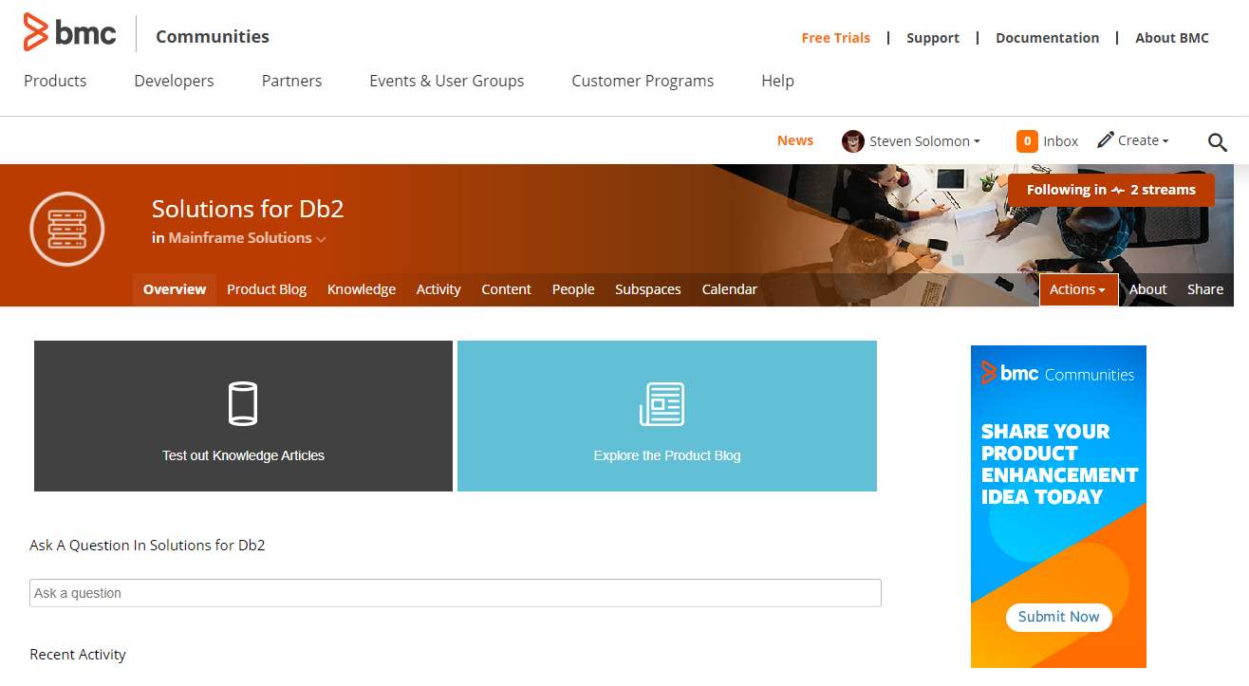
BMC Design Partner program
Request #1
Please join the BMC Communities
Request #2
Please accept the BMC Prerelease Click Through Agreement
https://communities.bmc.com/community/bmcdn/bmc_for_mainframes_and_middleware/db2

Slide 39
BMC AMI
Security
Systems
Cost
Data

